Slide 1
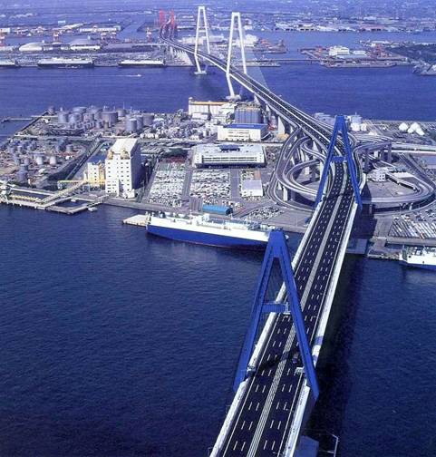
BRIDGE ENGINEERING

Slide 2
PART - C
SL NO | CHAPTER NAME | NO OF HOURS | MARKS
9 | Introduction to Bridge Engineering | 03 | 05
10 | Bridge foundation | 03 | 05
11 | Bridge Sub-structures & Superstructures | 05 | 12
12 | Highway Bridges | 04 | 08

Slide 3
PART-B ( Bridges)
9. Introduction - Bridge Engineering Elements of Bridges
Selection of site for a bridge
Types of bridges-scour-afflux –waterway
10 Bridge foundation Types of Bridge Foundation adopted – well Foundation- caisson's
Foundation and Coffer dams

Slide 4
PART-B ( Bridges)
11 Bridge Sub-structures & Superstructure Piers, types
Abutments, types
Wing walls, types
Bridge Bearings- Types
Application of IRC loading in design of bridges.
Approaches
12 Highway Bridges Steel bridges – girder bridges, suspension bridges- brief description with sketches
RCC bridges – cantilever bridges ,T-beam and deck slab bridges- brief description with sketches, Pre stressed concrete bridges-advantages-types-Flyovers, Underpasses etc

Slide 5
9.INTRODUCTION TO BRIDGE ENGINEERING
Bridges are structures built for carrying the road / railway traffic over a depression or obstruction such as river, channel, valley, road or railway.
If a bridge is constructed to carry highway traffic it is known as “HIGHWAY BRIDGE”
If a bridge is constructed to carry railway traffic it is known as “RAILWAY BRIDGE”
If a bridge is constructed exclusively to carry pedestrians it is known as “FOOT BRIDGE”

Slide 6
River
New Road Link
Existing Network
New Bridge
City Center

Slide 7


Slide 8


Slide 9
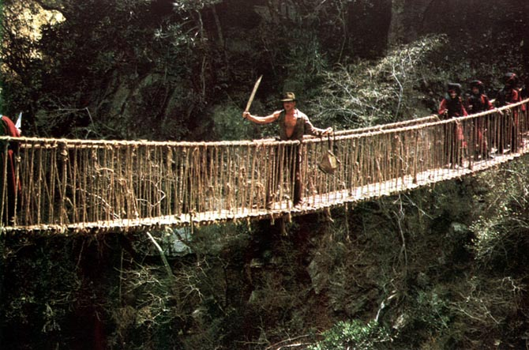

Slide 10
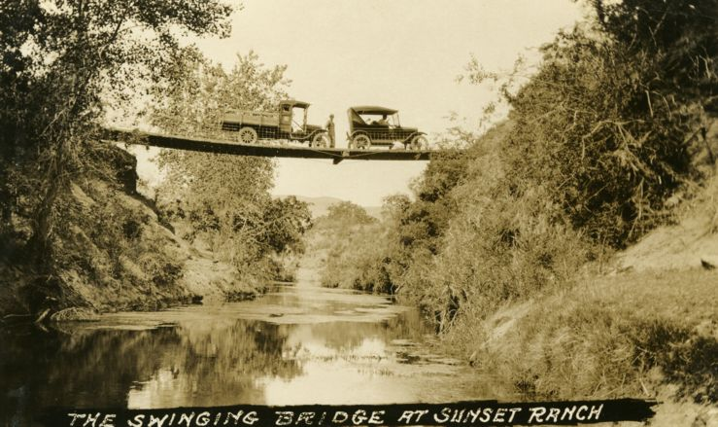

Slide 11
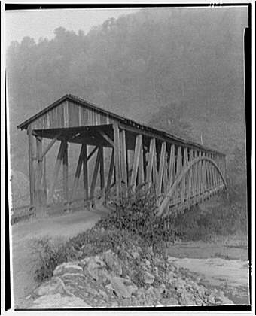

Slide 12
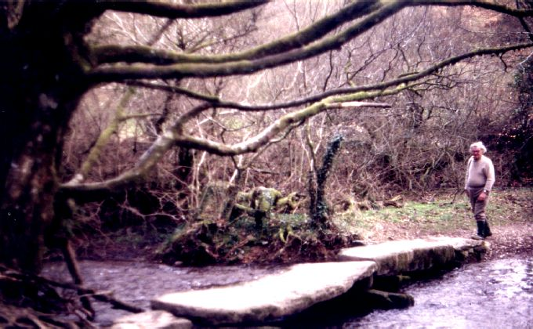
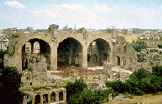
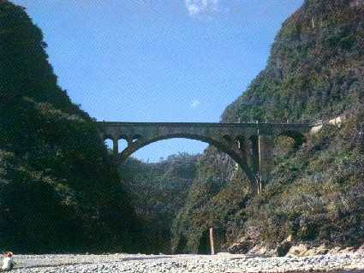
History of Bridge Development
100 B.C. Romans
2,104 years ago
700 A.D. Asia
1,304 years ago
Clapper Bridge
Tree trunk
Stone
Roman Arch Bridge
Great Stone Bridge in China
Natural concrete
made from mud
and straw
Low bridge
Shallow arch
Allows boats
and water to pass
through
Notes:
Clapper Bridges employed all over the world, most notably in England. Originally, tree logs used, but they tended to rot. Stones were better, but difficult to maneuver. The Romans developed highways that connected the empire. Bridges helped them do this.

Slide 13
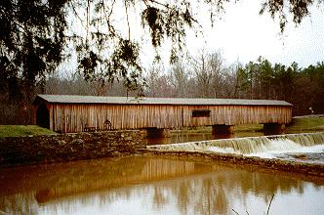

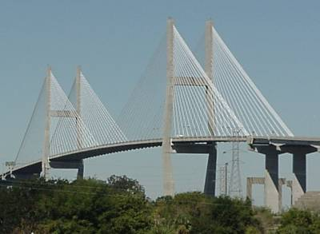
1900
History of Bridge Development
1920
Truss Bridges
Mechanics of Design
Wood
2000
Suspension Bridges
Use of steel in suspending cables
Prestressed Concrete
Steel

Slide 14
COMPONENT PARTS OF A BRIDGE
Sub structure
Super structure
Bearings
Ancillary works

Slide 15
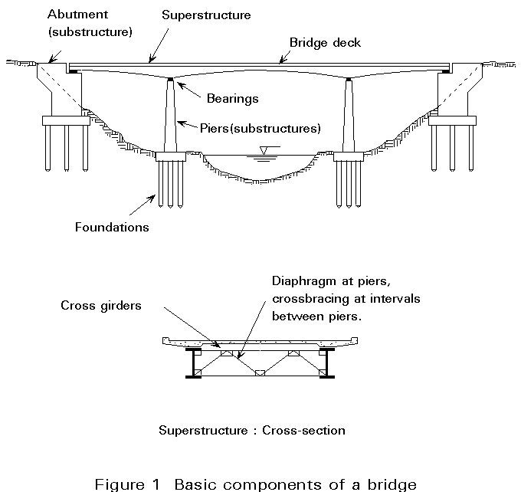

Slide 16
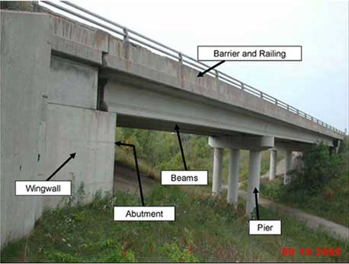

Slide 17
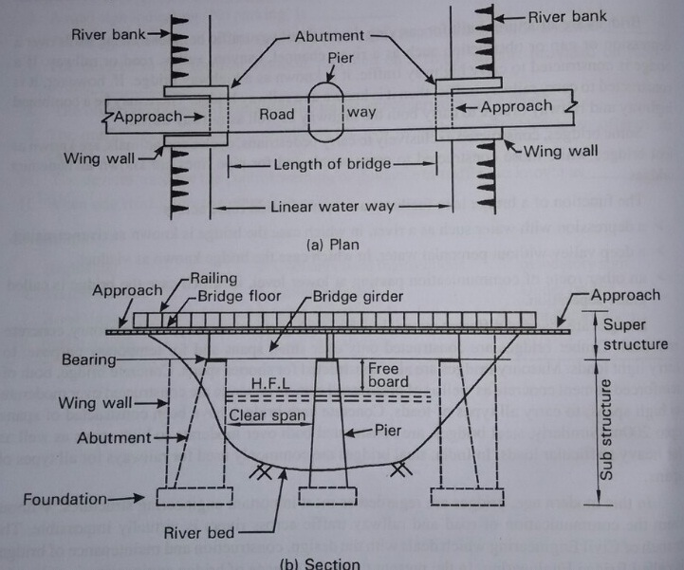

Slide 18
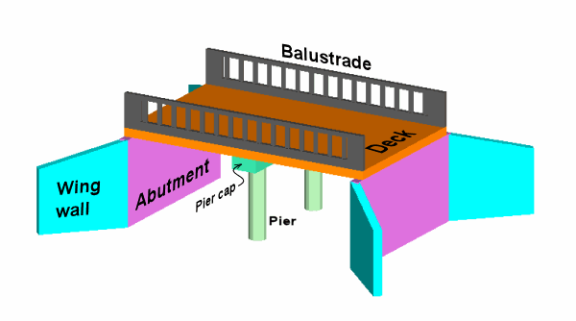

Slide 19
SELECTION OF SITE FOR BRIDGE SITE
The stream at bridge site should be well defined and as narrow as possible.
There should be a straight reach of stream at bridge site.
The site should be geologically sound.
Flow of water at bridge site should be steady.
stream should cross the bridge site at right angle.
No scouring & silting at bridge site.
Minimum obstruction to natural water way.

Slide 20
SELECTION OF SITE FOR BRIDGE SITE
Easy availability of Labour, Construction equipments, Materials, Transport facility near bridge site.
The stream at bridge site should have permanent firm, straight and high banks.
Should not be any sharp curves in approaches.
bridge should connect the roads on either side of river.
There should be adequate vertical height and water way in case of navigation bridges.
There should be no adverse environmental effect.

Slide 21
CLASSIFICATION OF BRIDGES
SL NO | ACCORDING TO | TYPE OF BRIDGE
01 | Life | Temporary bridge. Permanent bridge.
02 | Loading | Class AA Loading Class A Loading Class B Loading
03 | Span length | Culvert - <8M Minor bridges – 8-30M Major bridges - >30M Long span bridges - >120M
04 | Alignment | Straight bridges. Skew bridges
05 | Level of Bridge | Deck bridge Semi through bridges. Through bridges
06 | Position of HFL | Submersible bridges. Non submersible bridges.

Slide 22
CLASSIFICATION OF BRIDGES
SL NO | ACCORDING TO | TYPE OF BRIDGE
07 | Flexibility | Fixed span bridges. Movable bridges
08 | Purpose | Aqueducts. Viaducts. Grade separators. Foot bridge. Highway bridges. Railway Bridges.
09 | Materials used for construction | Timber bridge. Masonry bridge. Steel bridge. RCC bridge. PSC bridge
10 | Structural form | RCC T beam, Steel girder, Plate girder, Box girder, truss etc., Arch bridge Suspension bridge

Slide 23
SELECTION OF TYPE OF BRIDGE
Nature of river
Grades and alignment
Foundation condition
Soil condition
Hydraulic data
Climatic condition
Availability of material
Availability of skilled labour
Availability of Fund
Time limit
Volume and Nature of traffic
Level of HFL
Length and width of bridge
Navigation requirements
Live loads likely to come over

Slide 24
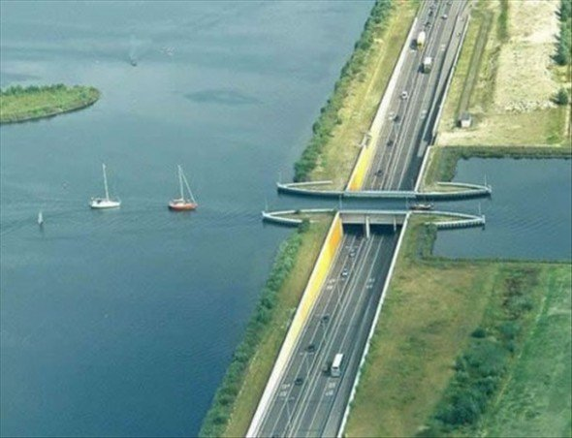
WATER WAY

Slide 25
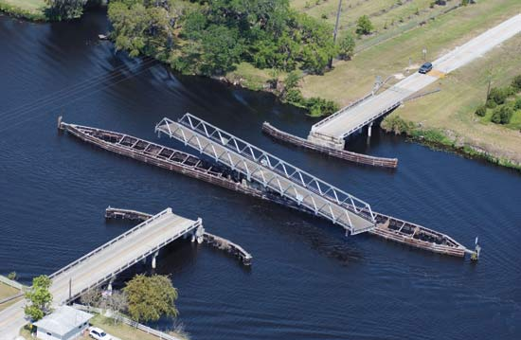
WATER WAY

Slide 26
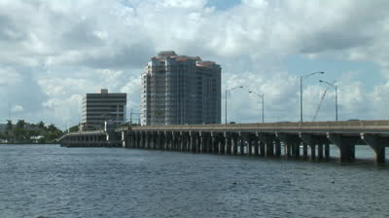
WATER WAY

Slide 27
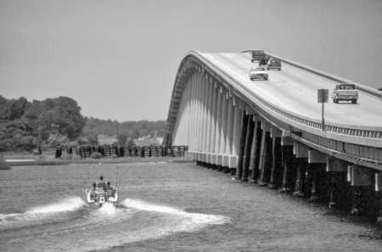
WATER WAY

Slide 28
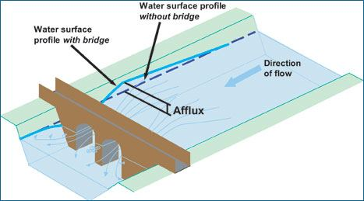
AFFLUX

Slide 29
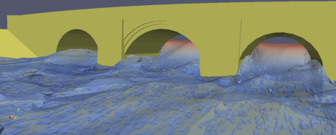
AFFLUX

Slide 30
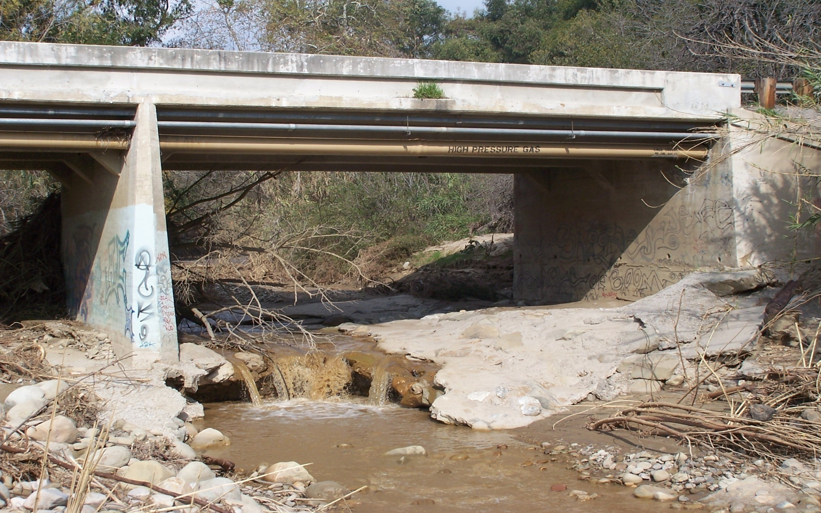
SCOURING

Slide 31
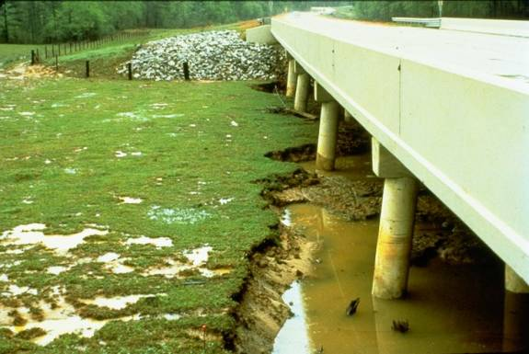
SCOURING

Slide 32
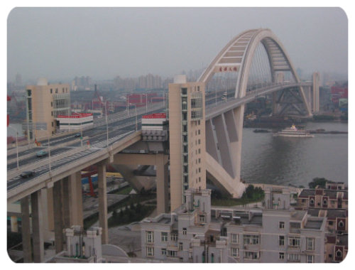
Free board

Slide 33
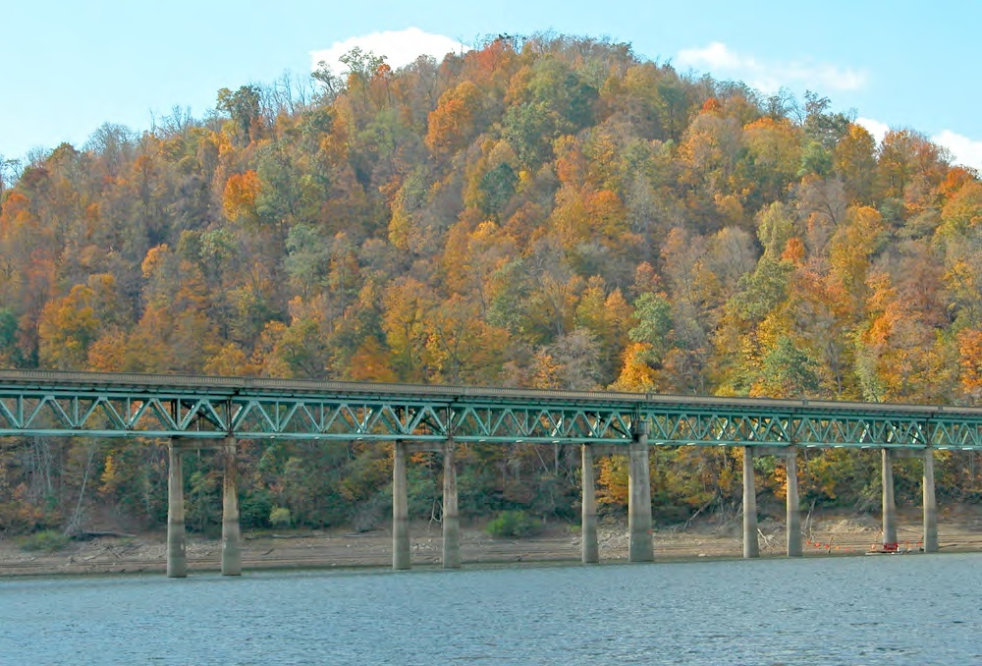
Free board

Slide 34
Free board
TYPE OF BRIDGE | FREE BOARD
ARCH | 300MM
GIRDER | 600-900MM
NAVIGABLE | 2400-3000MM
HIGH LEVEL BRIDGES | 600MM

Slide 35
10. BRIDGE FOUNDATOION
A foundation is a part of the structure which is directly in contact with the ground. It transfers the load of the structure to the soil below.

Slide 36
FUNCTIONS OF FOUNDATION
To provide a levelled base for the construction of pier and abutments.
To keep the intensity of pressure within safe limits of the bearing capacity of soil.
To prevent tilting and overturning of Pier and Abutment.
To prevent escape of supporting material of river bed.
To prevent unequal settlement of sub soil by transferring load uniformly.
To provide stability to the bridge.

Slide 37
FACTORS AFFECTING TYPE OF FOUNDATION
Nature of sub soil
Type of bridge.
Velocity of stream or river water.
LWL and depth of water at site.
Depth of scour.
Nature and extent of difficulties.
Availability of equipments.
Availability of skilled labour and materials.
Load on the foundation.

Slide 38
TYPES OF FOUNDATION
Shallow foundation.
Deep foundation.
Open foundation
Raft foundation.
Pile foundation
Well foundation.

Slide 39
TYPES OF PILES
Bearing piles.
Friction piles.
Sheet piles.
Fender piles.
Anchor piles.
Batter piles.
Compaction piles.
Screw piles.

Slide 40
TYPES OF COFFER DAMS
Earth fill cofferdam
Rock fill cofferdam
Rock fill crib cofferdam
Single wall cofferdam
Double wall cofferdam
Cellular cofferdam.
Concrete cofferdam
Suspended cofferdam

Slide 41
11. BRIDGE SUB STRUCTURE AND SUPER STRUCTURE
Piers
Abutments
Wing walls
Approaches

Slide 43
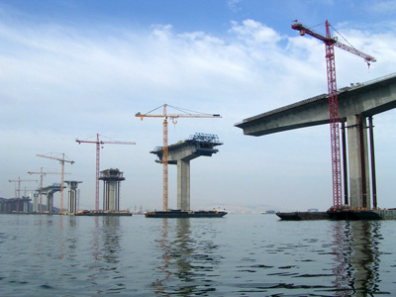
PIERS

Slide 44
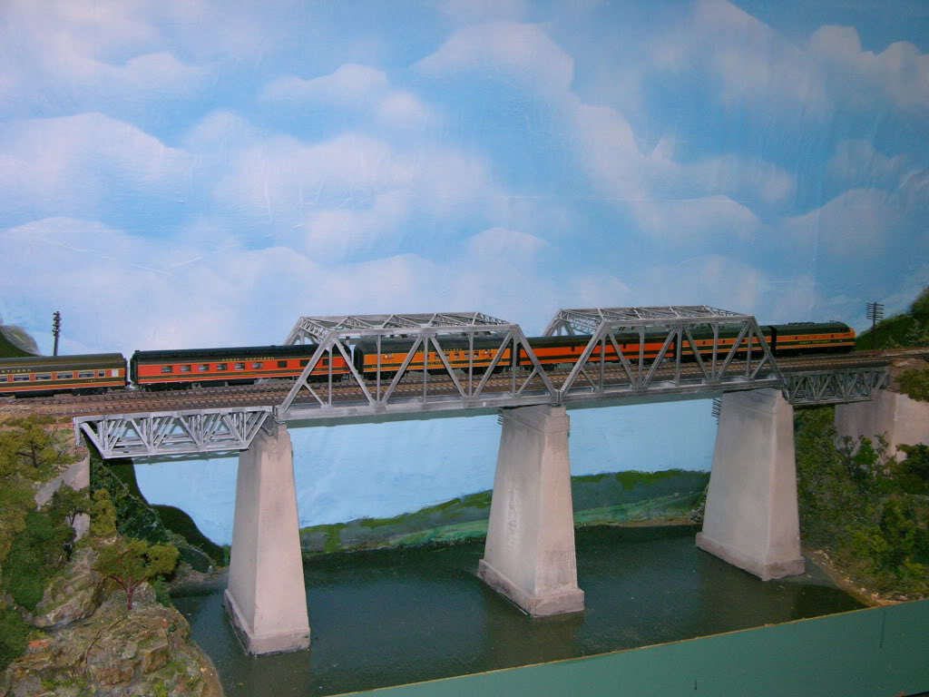

Slide 45
SILENT FEATURES OF PEIRS
HEIGHT : The height of the pier is measured from top of its foundation up to its support level of girder.
PEIR WIDTH : The top width of pier sufficient to accommodate two bearings with 150mm seat . Minimum width of 750mm.
PIER BATTER : The side of the masonry pier may kept vertical or battered. 1 in 20 to 1 in 24 is provided.
LENGTH OF PEIR : The length of pier should be at least equal to the width of the bridge.
Pier cap : Top of pier is covered with concrete blocks by projecting 75mm outwards. It uniformly distributes load from bearing to pier
Cut & Ease water:

Slide 46
TYPES OF PEIRS
Solid piers
Open piers
Cylindrical piers
Column bents.
Pile bents
Trestle bents.

Slide 47
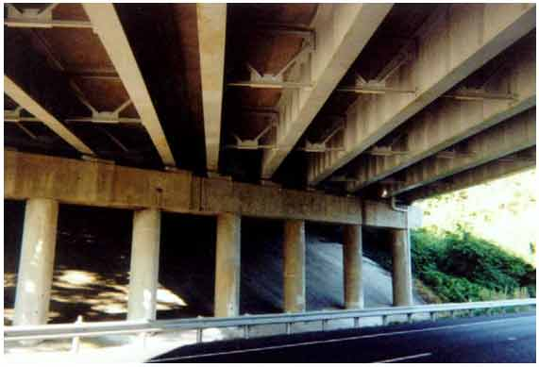
CYLINDRICAL PIERS

Slide 48
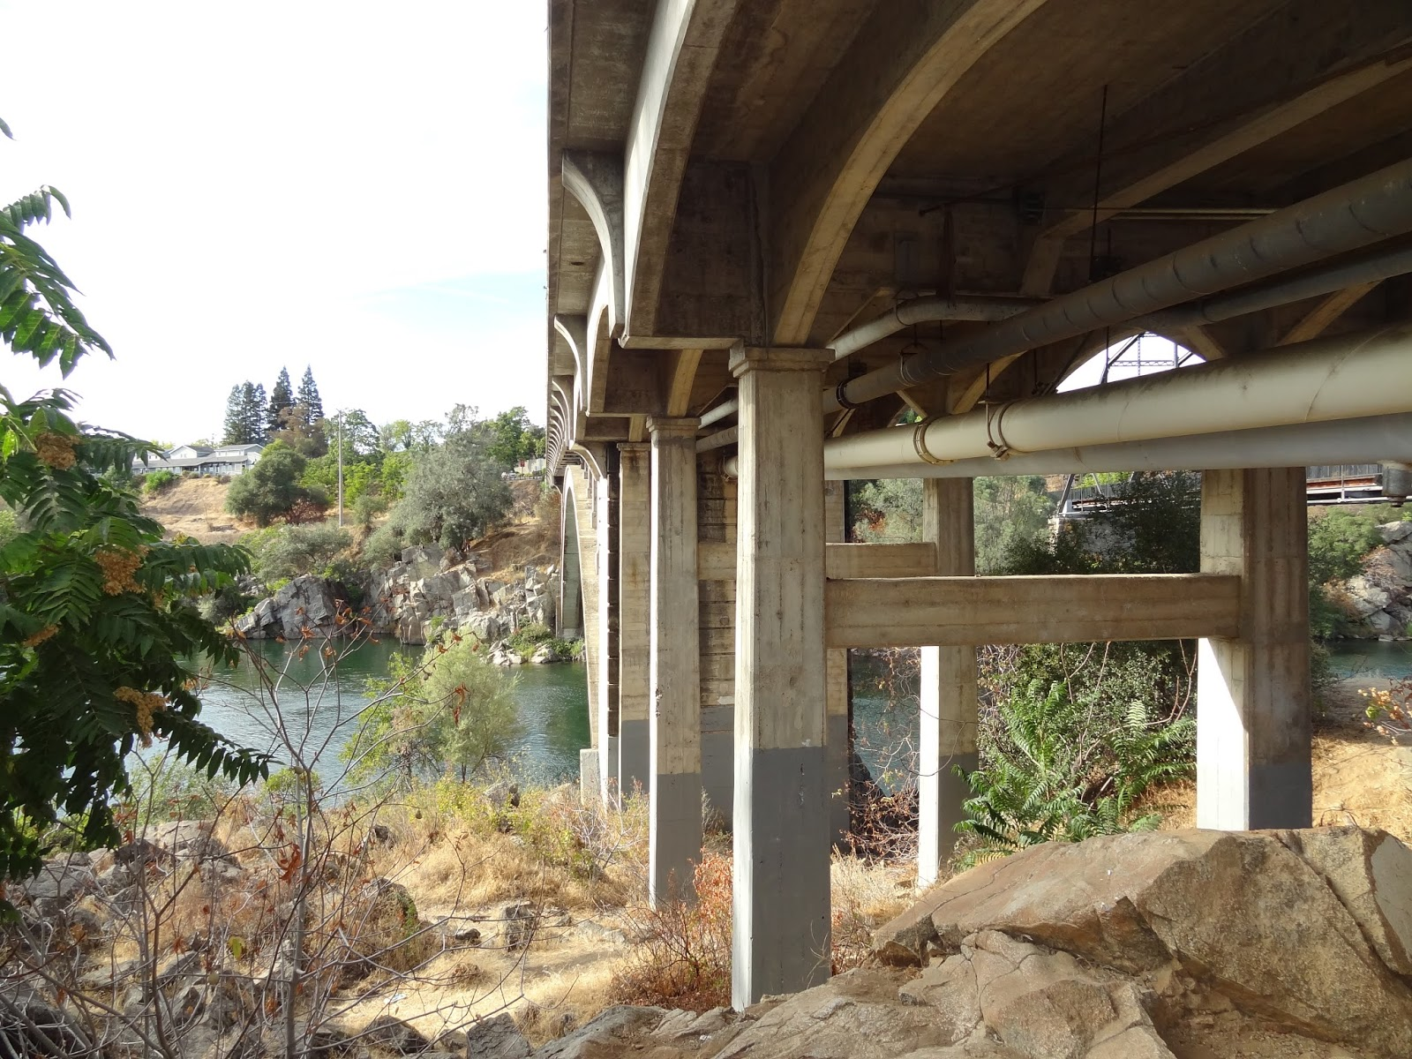
COLUMN BENTS

Slide 49
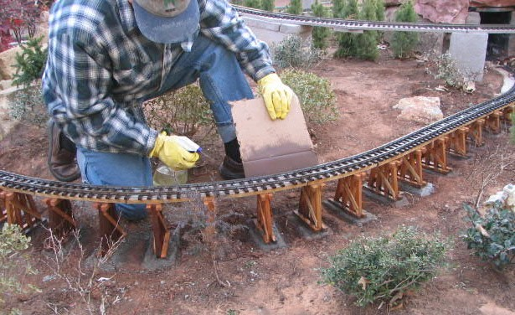
TRESTLE BENTS

Slide 50
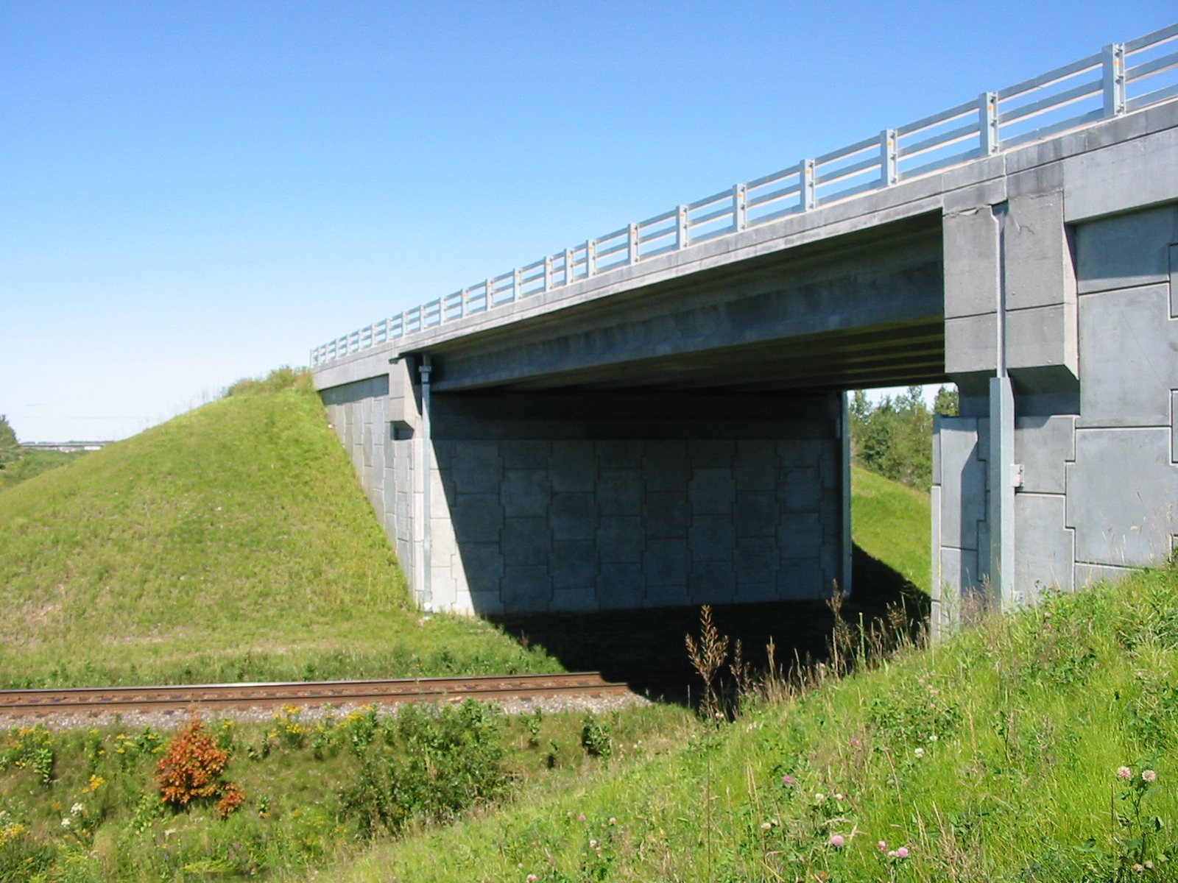
ABUTMENTS:

Slide 51
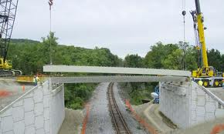

Slide 52
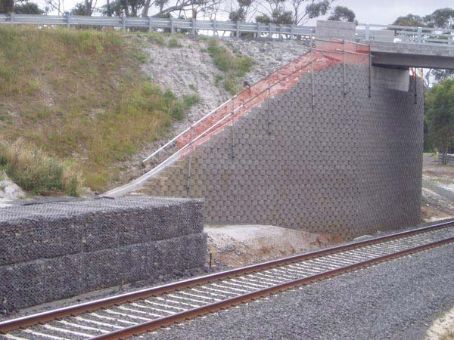

Slide 53
FEATURES OF ABUTMENT:
Height: difference between bed level of river bank and formation level of road.
Batter: water face kept vertical, face retaining earth is provided with 1 in 6 or stepped down.
Width : The top width is sufficient to accommodate ends of bridge super structure.
Length: length represents overall width of bridge.
Abutment cap :

Slide 54
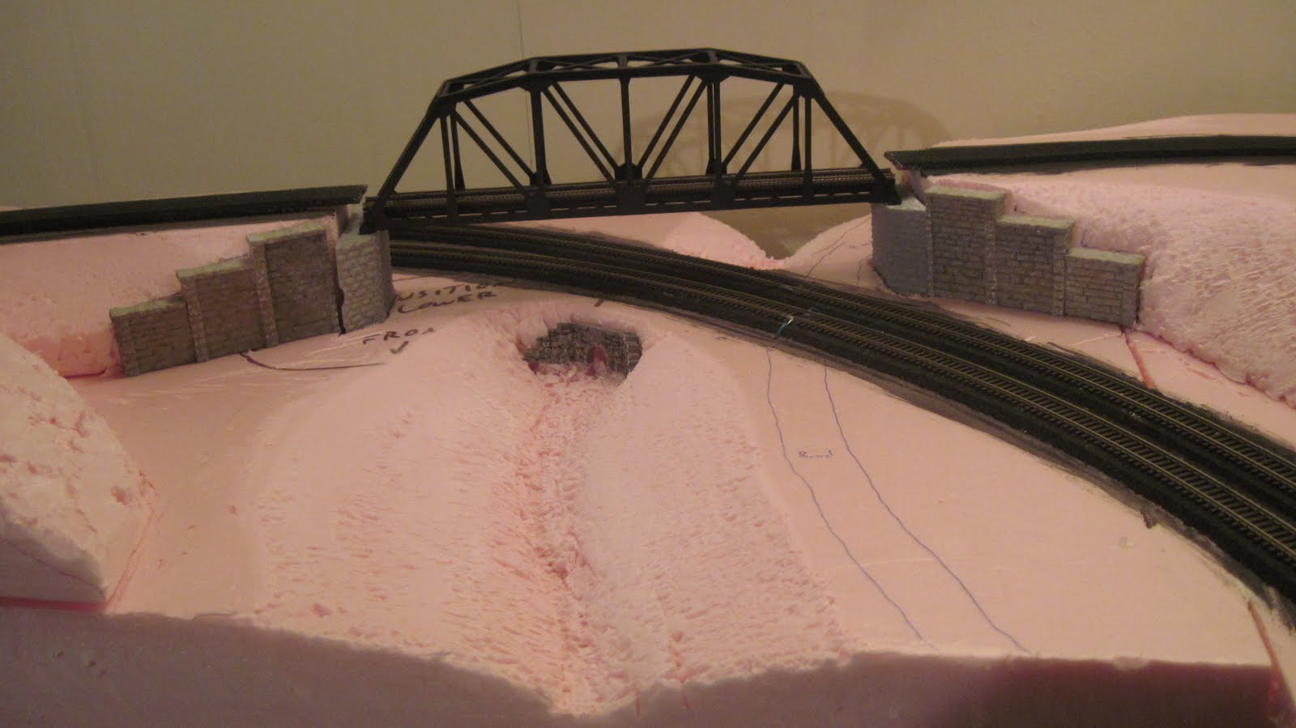

Slide 55
Classification of abutments
Abutment without wing wall
Straight abutment
Tee abutment
Hollow or arch abutment
Burried Abutments
Abutment with wing wall
Abutment with straight wing wall
Abutment with return wing wall
Abutment with splayed wing wall

Slide 56
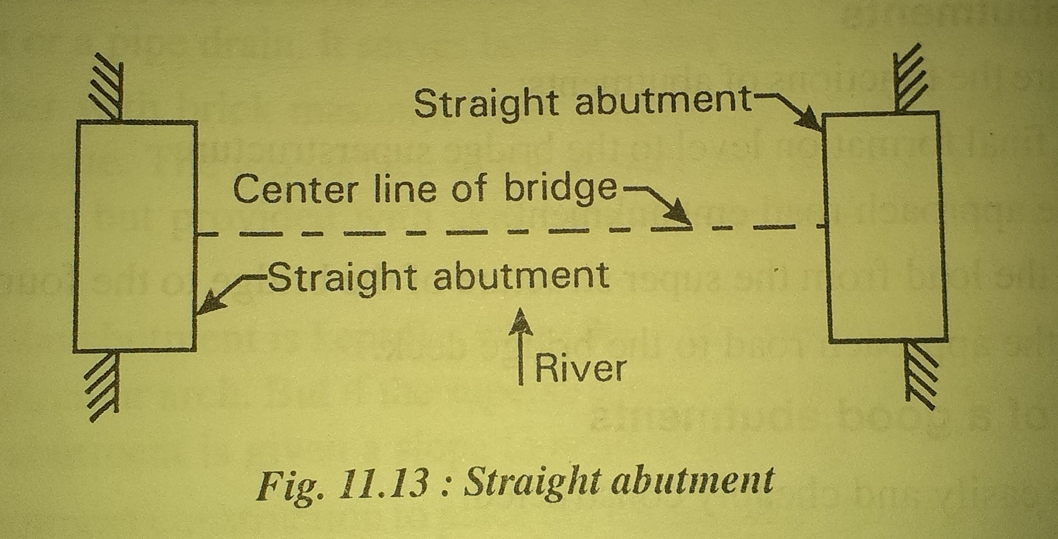
STRAIGHT ABUTMENT

Slide 57
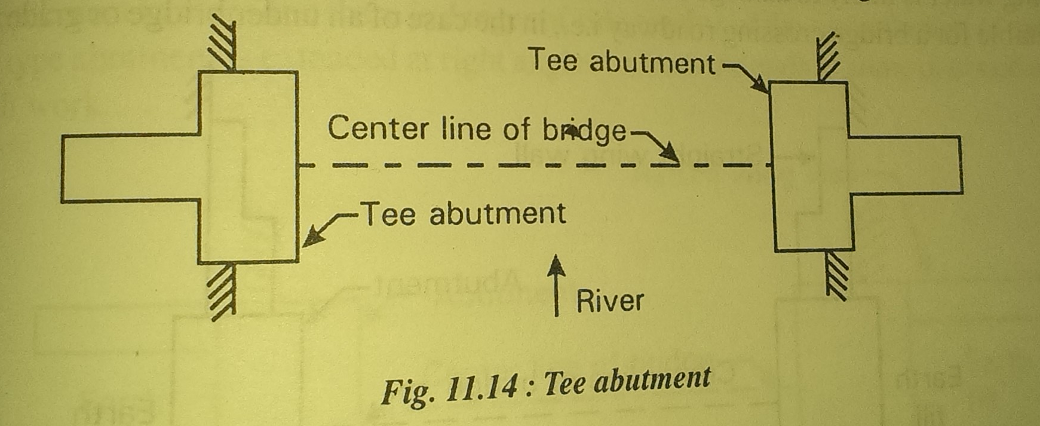
TEE ABUTMENT

Slide 58
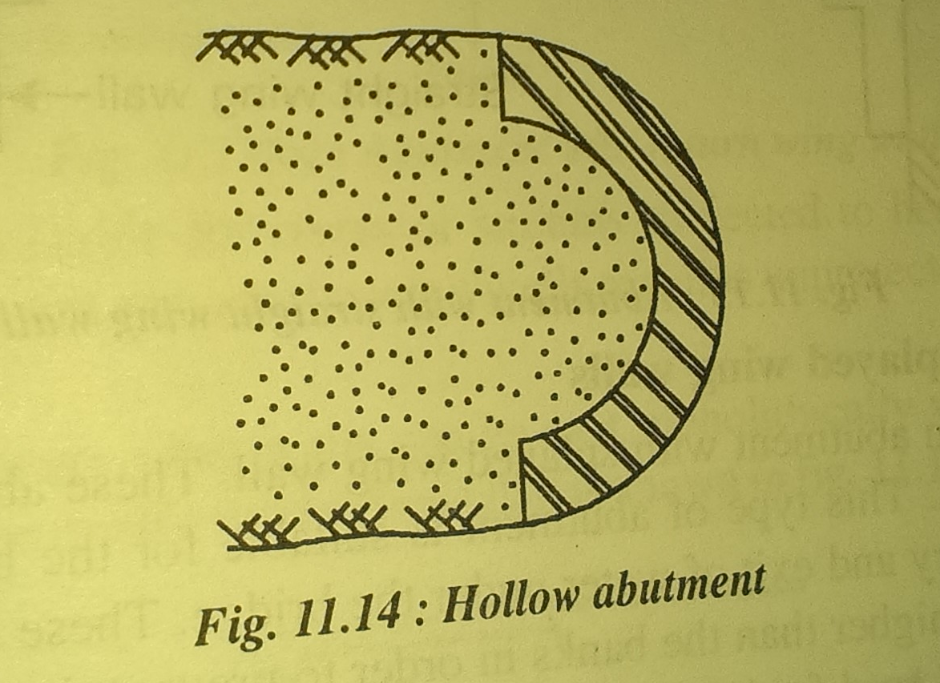
HOLLOW ABUTMENT

Slide 59
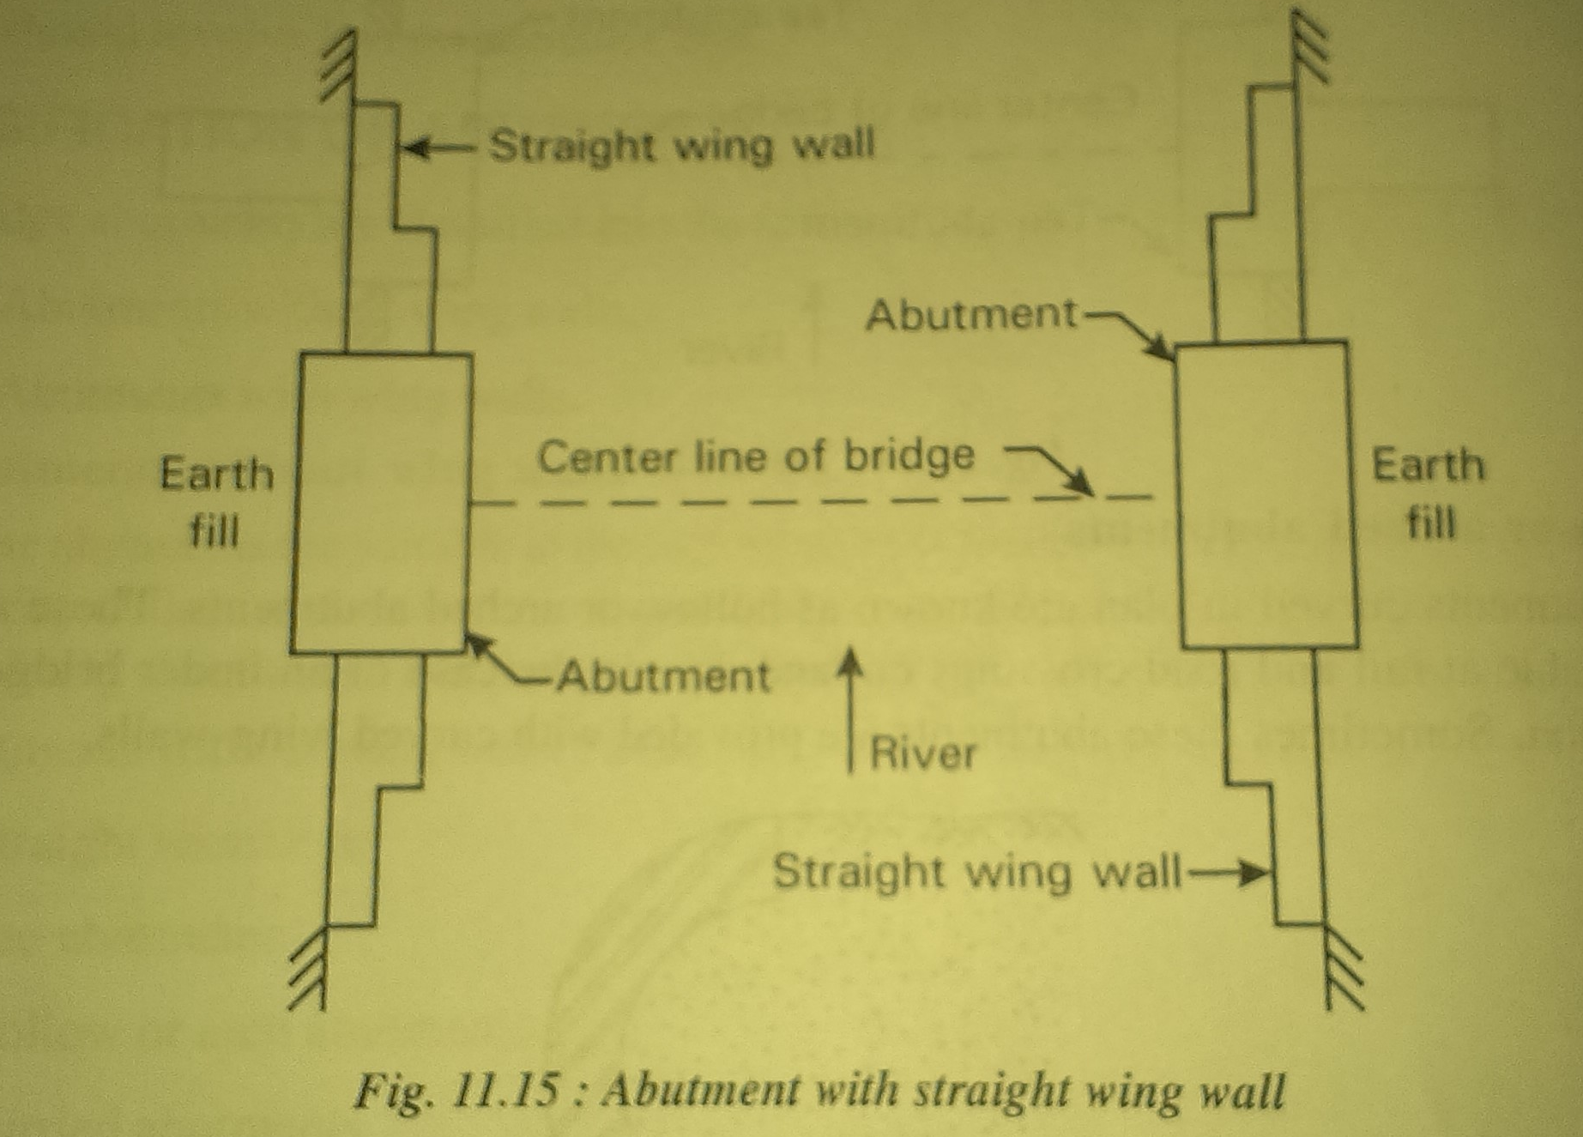
ABUTMENT WITH STRAIGHT WING WALL

Slide 60
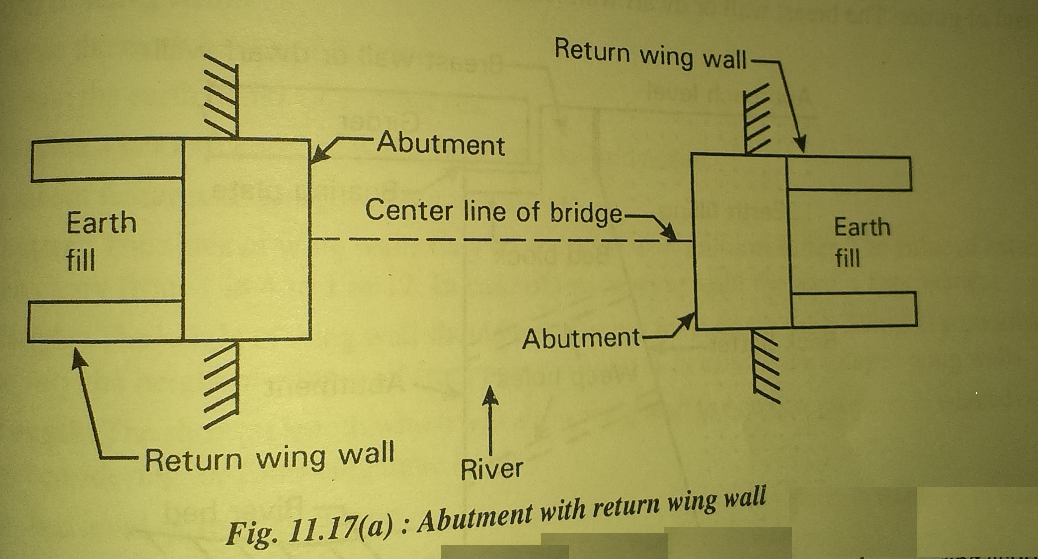
ABUTMENT WITH RETURN WING WALL

Slide 61
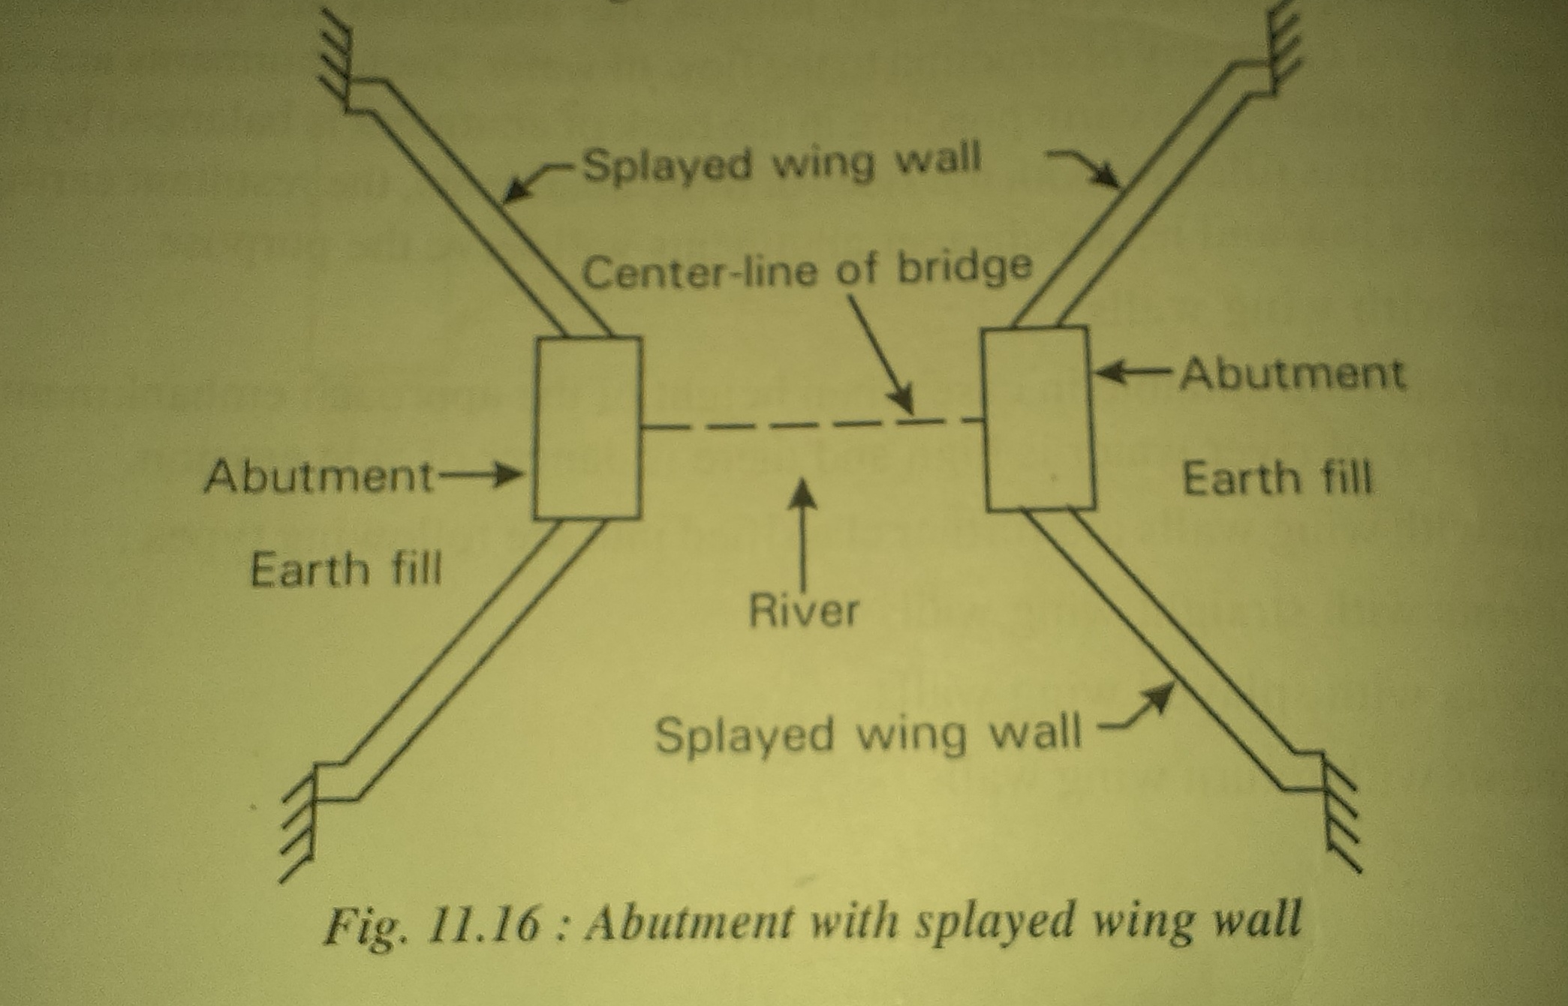
ABUTMENT WITH SPLAYED WING WALL

Slide 62
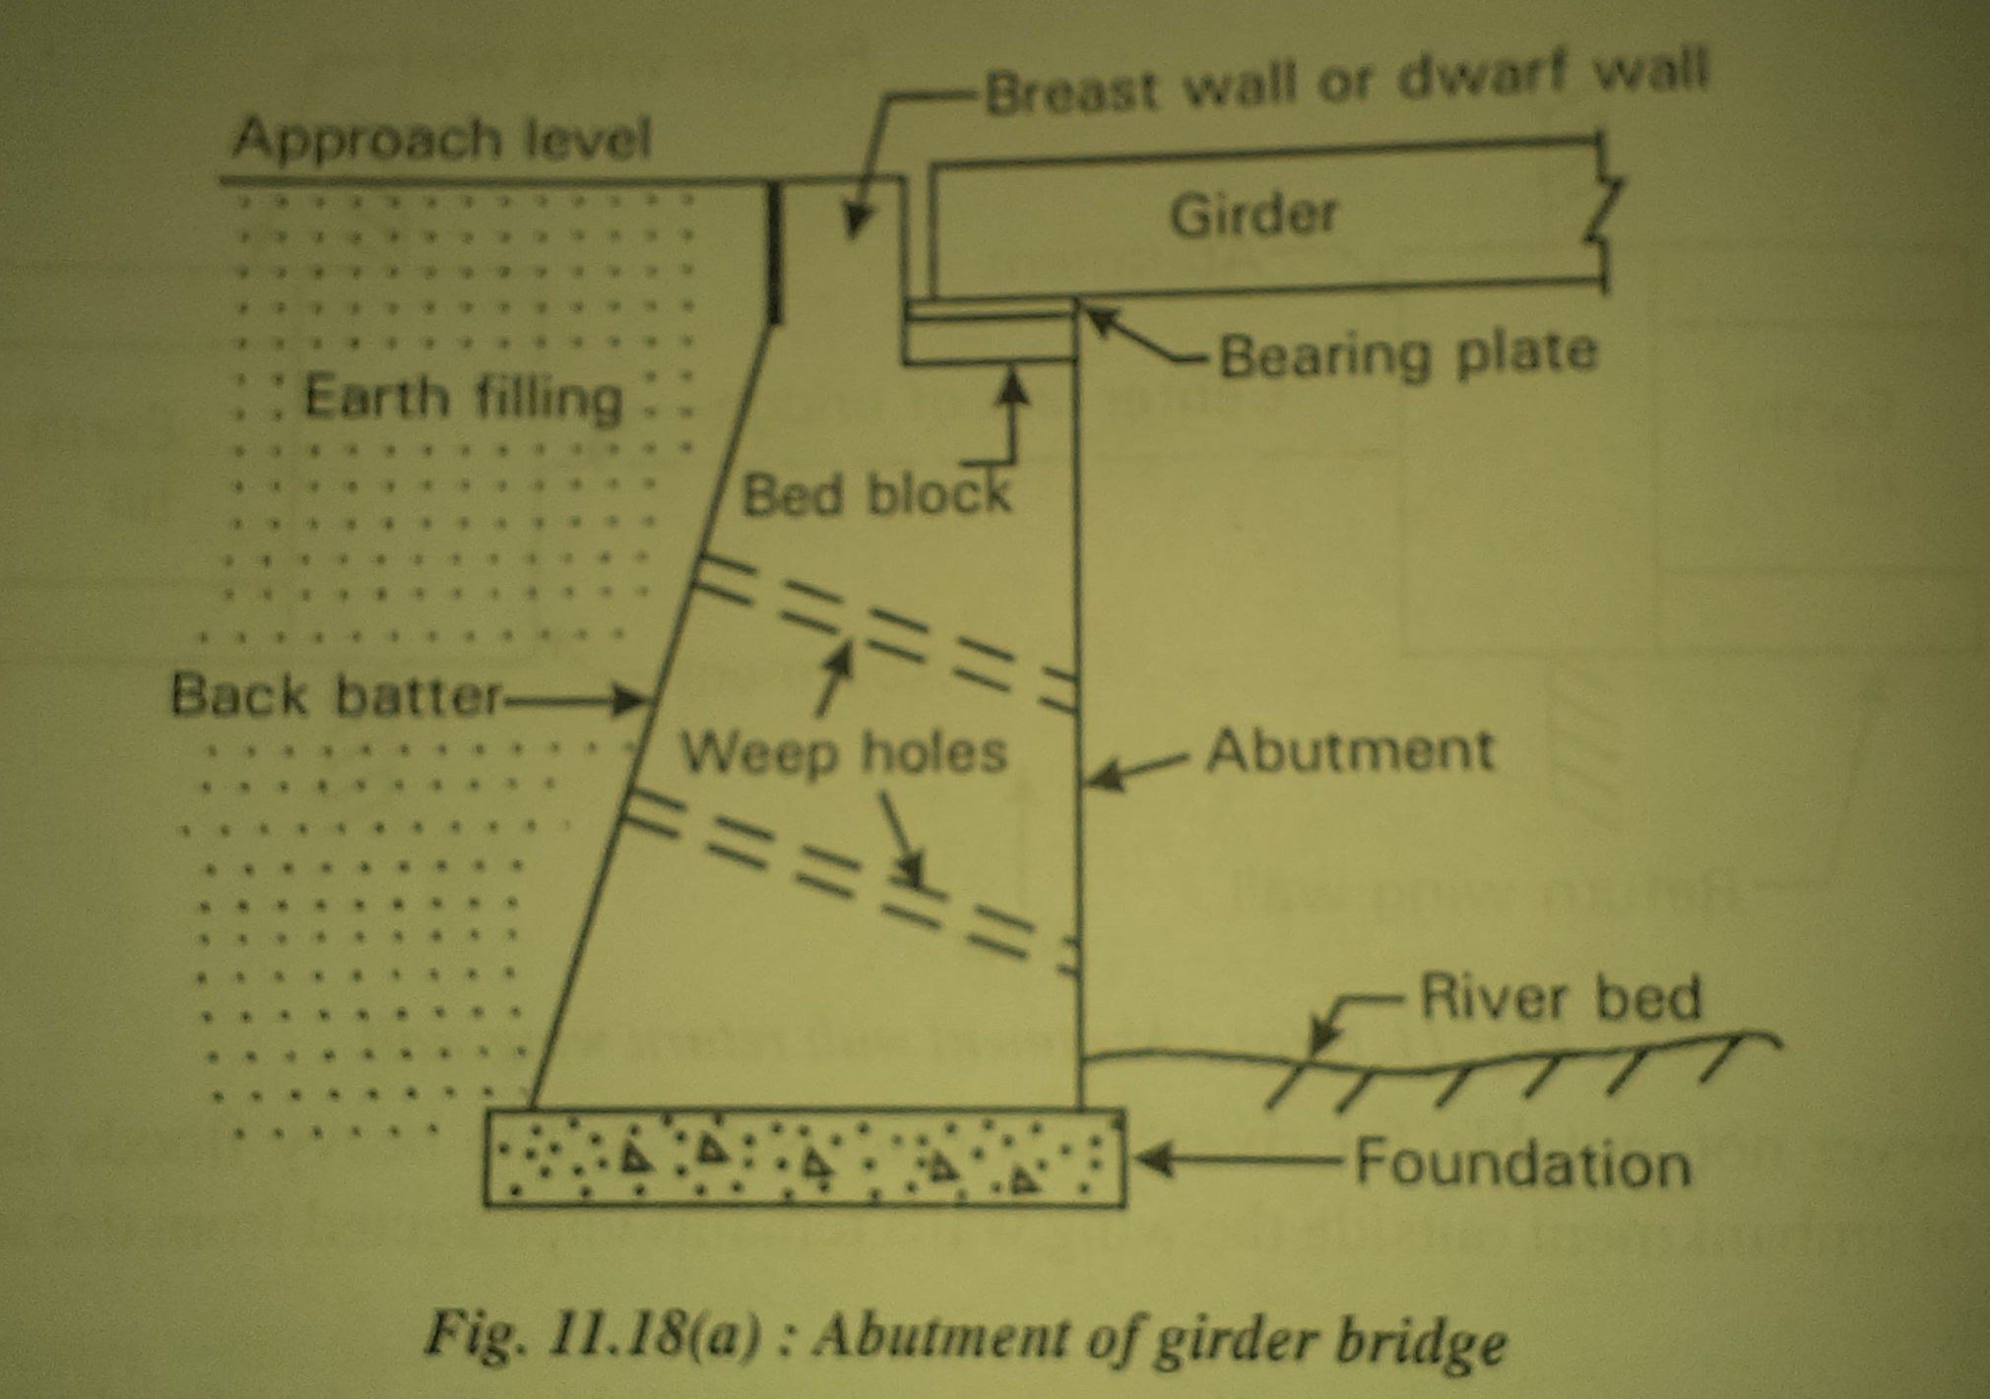
ABUTMENT FOR A GIRDER BRIDGE

Slide 63
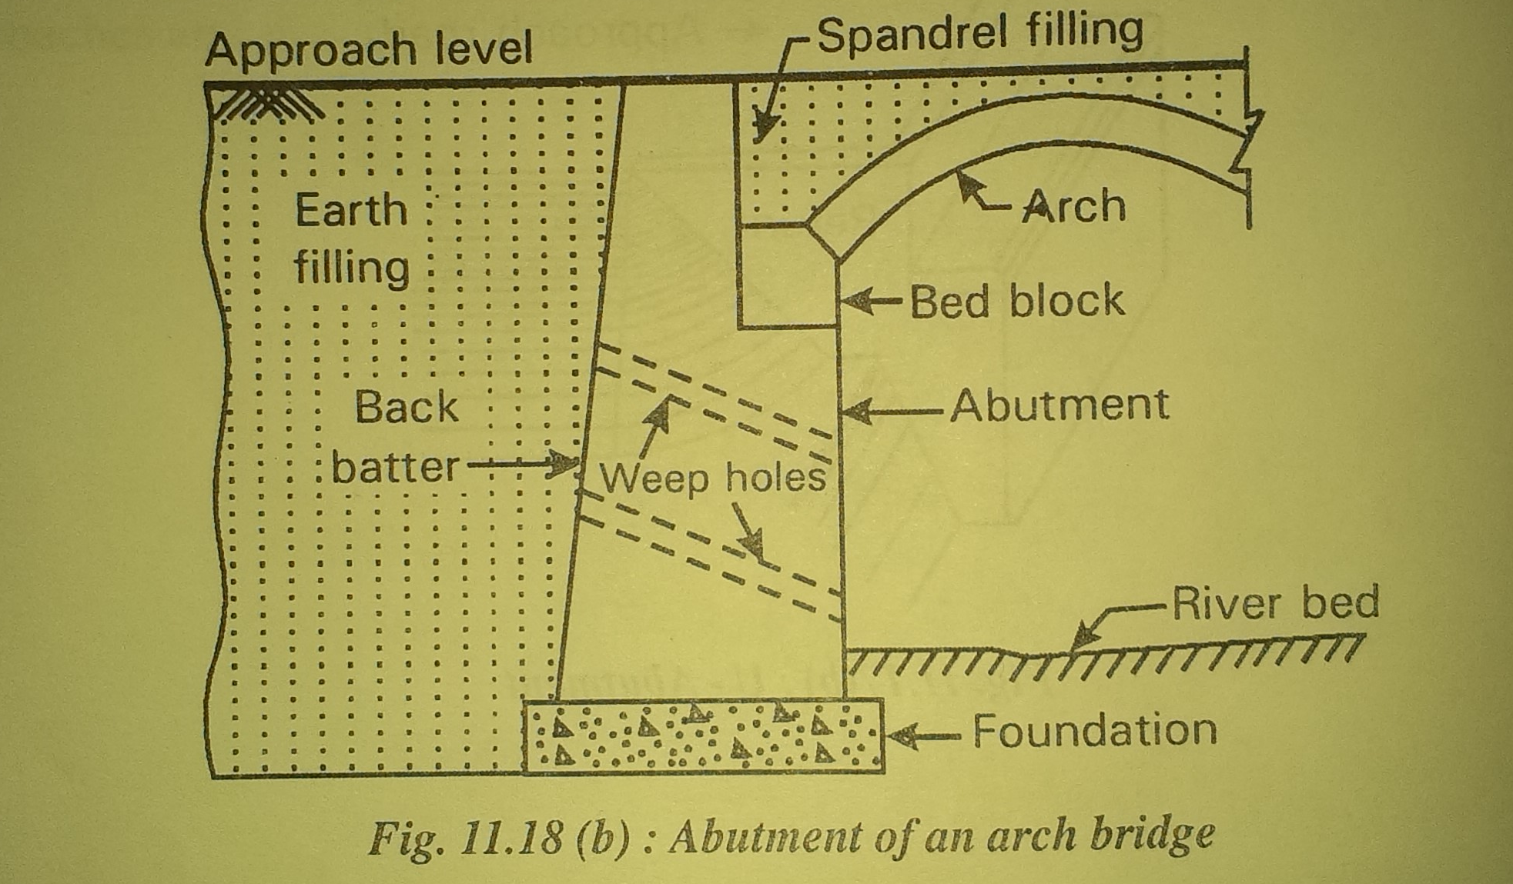
ABUTMENT FOR A ARCH BRIDGE

Slide 64
WING WALLS

Slide 65
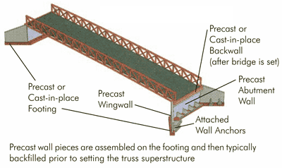

Slide 66
SILENT FEATURES OF WING WALL
HEIGHT : The height of the wing wall should be sufficient to retain the earth filling. Height from point to point vary in case of splayed wing wall.
LENGTH: Bed level of the stream, Formation level of road, Natural ground level of embankment
BATTER: Provided with uniform batter, 1 in 4 to 1 in 12, face kept vertical in case of return wing wall.
TOP WIDTH: depends on type of wing wall, generally 500mm.
WEEP HOLES: to drain off water from back filling.

Slide 67
TYPES OF WING WALLS
STRAIGHT WING WALL
RETURN WINGWALL
SPLAYED WING WALL

Slide 68
APPLICATION OF IRC LOADING
IRC class AA Loading
IRC class 70R Loading
IRC class A Loading
IRC class B loading

Slide 69
IRC CLASS AA LOADING
Two types tracked or wheeled vehicle
Army tank of 700kn in tracked loading
Heavy duty army truck of 400kn in wheeled loading.
All the bridges on NH, SH have designed for this load.
Alternatively another type Class 70R is used instead of Class AA Loading,

Slide 70
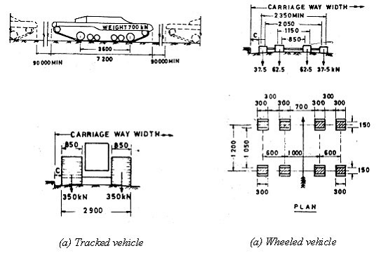
IRC Class AA Loading

Slide 71
I R C LOADING
IRC Class AA Loading
700KN and 400KN, NH, SH
IRC class 70R Loading
700KN, 400KN, 1000KN
IRC Class A Loading
8 wheels, 27KN to 114KN, 554KN, Culverts and Permanent bridge
IRC Class B Loading
332KN, Temporary

Slide 72
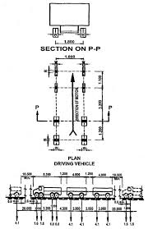

Slide 73
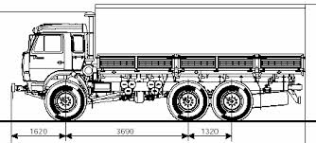

Slide 74
BRIDGE BEARINGS
Cement mortar pad.
Expansion bearing.
Sliding bearing.
Rubber bearing.
Solo plate bearing.
Neoprene bearing pads.
Knuckle bearing.
Rocker and roller bearing.
Rocker bearing.

Slide 75
FUNCTIONS OF BRIDGE BEARINGS
To distribute the load.
To take up vertical movements due to sinking of support.
To transfer horizontal forces developed due to application of breaks.
To provide longitudinal movements due to temp variations.
To provide angular movement due to deflection.

Slide 76
REQUIREMENTS OF IDEAL BRIDGE BEARING
Compact in size & Easy to install.
offer resistance to weather.
Capable to distribute the load imposed on it.
Minimum maintenance cost.
Initial cost should not be very high.
Allow maximum expected movement of deck.

Slide 77
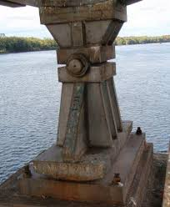

Slide 78
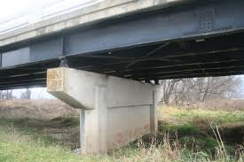

Slide 79
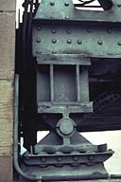
EXPANSION BEARING

Slide 80
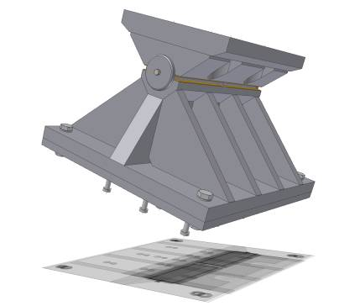
ROLLER AND ROCKER BEARING

Slide 81
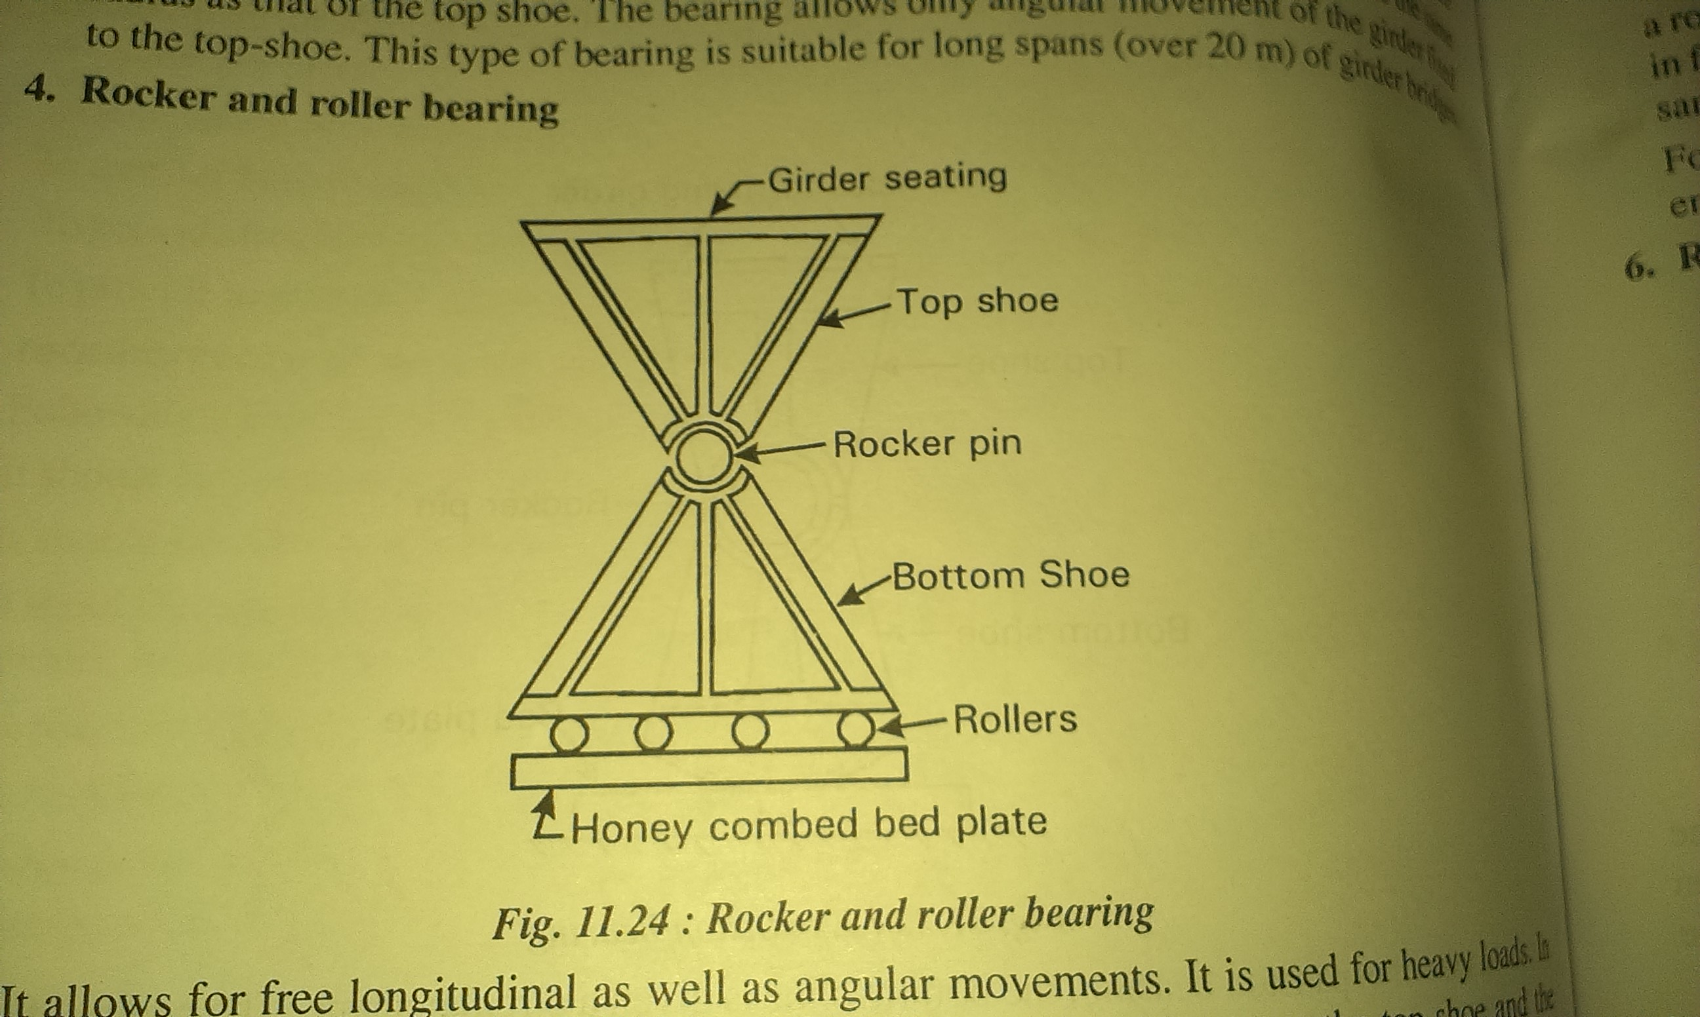

Slide 82
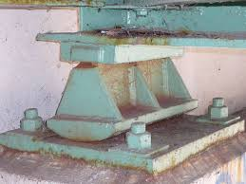
ROCKER BEARING WITH CURVED BOTTOM

Slide 83


Slide 84


Slide 85


Slide 86
12. HIGHWAY BRIDGES

Slide 87




Engineering project:
Research
Design
Construct
Test
Criticise and Improve!

Slide 88
Live Loads are applied to the DECK. The DECK transmits live loads and deck dead load to the SUPERSTRUCTURE. The SUPERSTRUCTURE transmits these loads and the superstructure dead load to the SUBSTRUCTURE.
Deck
Substructure
Superstructure
Earth

Slide 89
The SUBSTRUCTURE transmits all these loads and the substructure dead load to the EARTH. The EARTH supports the bridge and all its loads. It’s all about LOAD PATHS.
Deck
Substructure
Superstructure
Earth

Slide 90


Slide 91


Slide 92


Slide 93


Slide 94

BOX GIRDER BRIDGE

Slide 95





Truss - Creates both a very rigid structure
It transfers the load from a single point to a considerably wider area

Slide 96


Slide 97


Arch bridges
Always under compression.
The force of compression is pushed outward along the curve of the arch to the piers.
This greatly reduces the effects of tension on the underside of the arch.
The smaller the semicircle of the arch, the greater the tension relief effect.

Slide 98


Truss Type - Bowstring

Slide 99


Truss Type - Lenticular

Slide 100


Truss Type - Pratt

Slide 101


Truss Type – Double Intersection Pratt

Slide 102


Truss Type – Baltimore

Slide 103


Truss Type – Parker

Slide 104


Truss Type – Pennsylvania

Slide 105


Truss Type – Warren

Slide 106


Truss Type – Warren

Slide 107


Truss Type – Warren

Slide 108
Truss Type – Warren

Slide 109
IMAGES OF SOME OF THE BEAUTIFUL BRIDGES IN UNIVERSE

Slide 110

Astoria bridge

Slide 111

Tsing Ma Bridge, Hong Kong

Slide 112

Clark Bridge in Alton

Slide 113

Dames Port Florida

Slide 114

Dames Port Florida

Slide 115


Slide 116

BRIDGE ACROSS SHATT-AL-ARAB, IRAQ

Slide 117

Sault Ste. Marie International Bridge

Slide 118

GUIABA RIVER AT PORTO ALEGRE, BRAZIL

Slide 119

Cape Cod Canal Railroad Bridge
Buzzards Bay,

Slide 120


Slide 121

Cold Spring Arch Bridge, Santa Barbara

Slide 122


Slide 123


Slide 124


Slide 125


Slide 126

GOLDAN GATE BRIDGE

Slide 127

HANGZHOU BAY BRIDGE

Slide 128


Slide 129


Slide 130


Slide 131


Slide 132


Slide 133


Slide 134


Slide 135


Slide 136


Slide 137


